Slide 1
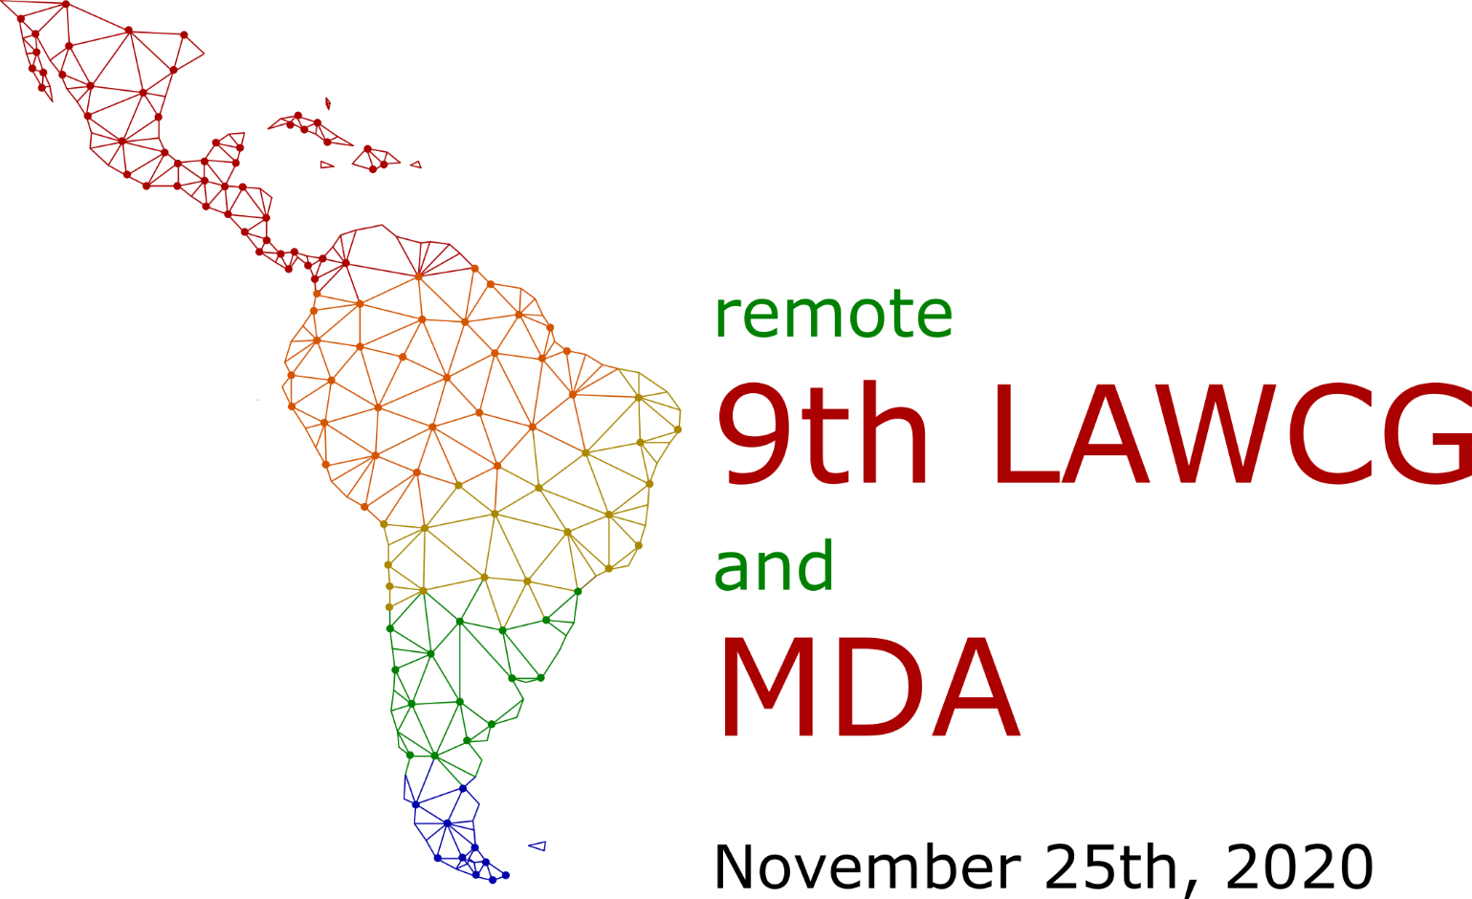
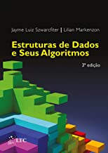
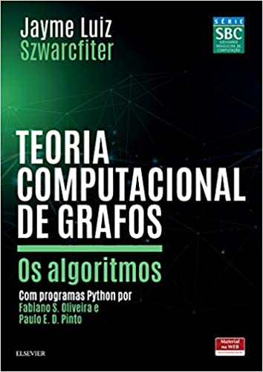
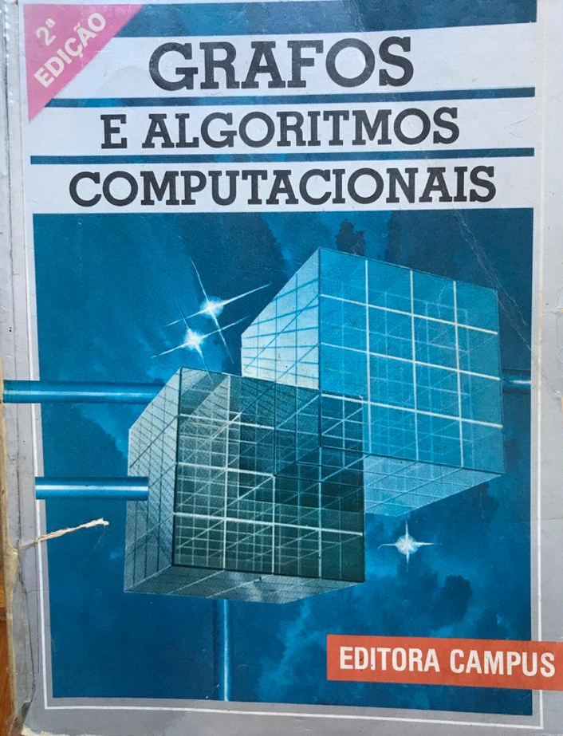
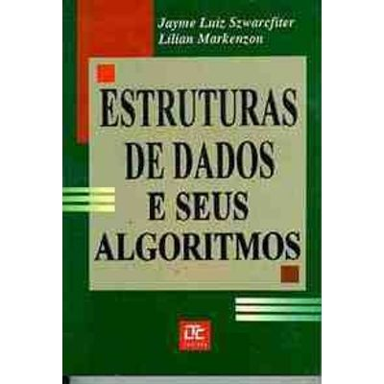
Computational Graph Theory: Algorithms
Szwarcfiter, Jayme Luiz – COPPE/UFRJ – jayme@nce.ufrj.br, Oliveira, Fabiano S. – IME/UERJ – fabiano.oliveira@ime.uerj.br, Pinto, Paulo E. D. – IME/UERJ– pauloedp@ime.uerj.br
Introduction
Short Biography
This work describes algorithms in graphs. That is, it formulates and explains methods and processes to solve various problems and issues of interest involving graphs, through a computer. Many of these graph problems are of great practical importance, as they serve as models for solving various problems in which we are forced to use the computer. A constant concern in the exposure of the algorithms is computational efficiency, to guarantee the direct use of the methods.
In 1967, he graduated in electronic engineering from UFRJ. He completed his master's degree in 1971 at COPPE. In 1975 he obtained a Ph.D. in Computer Science from the University of Newcastle Upon Tyne, England.
Table 1: Academic life
Table 2: Recent Awards
Degrees | Year
Electronic Engineering | 1967
Master | 1971
Ph. D. | 1975
Recent Awards | Year
Elon Lages Lima 2019 Award, Brazilian Society of Mathematics and Brazilian Society of Applied and Computational Mathematics. | 2019
Louis Leloir Award 2014, Ministry of Science, Technology and Product Innovation, Argentina. | 2014
Grand Cross of the National Order of Scientific Merit 2010, Ministry of Science and Technology. | 2013
Objective
The objective of this work is to honour Professor Jayme Luiz Szwarcfiter who reached the mark of 42 oriented doctoral theses.
He is currently Full Professor and Emeritus at UFRJ. In 2001, the Journal of the Brazilian Computer Society dedicated a special edition to prof. Jayme contemplating his main publications. Among others, Jayme wrote articles in conjunction with Adrian Bondy [1], Donald E. Knuth [3], and Christos H. Papadimitriou [2]. He received several awards and distinctions, including the Álvaro Alberto do Ciência e Tecnologia Award, MCTI-CNPq; the Giulio Massarani Award for Academic Merit from COPPE; the Scientific Merit Award from the Brazilian Computer Society; the Louis Leloir Award from the Ministry of Science, Technology and Productive Innovation in Argentina; the degrees of Commander and Grand Cross of the National Order of Scientific Merit, MCTI; among others.
An Introduction to Graph Theory
Figure 1: Jayme’s recent books “Data Structure and its Algorithms”, 2017 and “Computational Graph Theory: Algorithms”, 2018.
Conclusions
Basic Techniques
Professor Jayme has an important contribution to the formation of human resources as he advised dozens of masters and doctors who are currently teaching at various universities in the country and abroad. He has reached the mark of 42 oriented doctoral theses, and most of his 161 journal papers are fruit of his work as supervisor and of his network of collaborators [4].
In general, an algorithm to solve a certain problem in a graph assumes that it is represented in an appropriate form. On the other hand, it would also be that the graph was supplied to the algorithm in a simple way to be specified. It is reasonable, for example, that this specification matches your sets of vertices and edges, respectively.
References
^{[1]} BONDY, Adrian ; DURAN, Guillermo ; LIN, Min Chi ; SZWARCFITER, J. L. . Self-Clique Graphs and Permutation Matrices. J. G. T., v. 44, p. 178-192, 2003.
^{[2]} ITAI, A. ; PAPADIMITRIOU, C. H. ; SZWARCFITER, J. L. . Hamilton Paths in Grid Graphs. SIAM J. on Comp., v. 11, p. 676-686, 1982.
^{[3]} KNUTH, D. E. ; SZWARCFITER, J. L. . A Structured Program to Generate All Topological Sorting Arrangements. Inform. Process. Lett., v. 6, p. 153-157, 1974.
^{[4]} LUCCHESI, C. L. ; MELLO, C. P. ; SZWARCFITER, J. L. . On Clique Complete Graphs. Discrete Math., v. 183, p. 247-254, 1998.
Acknowledgment
Figure 2: Jayme’s first two books “Graphs and Computational Algorithms”, 1984 and “Data Structure and its Algorithms”, 1994.

